Slide 1
Text Mining & NLP Git, R, R-Studio

Slide 2
The course uses three software components for learning.
In the next sections, skip to the method you want to use Local (Mac or Windows, Virtual Machine, Cloud/Hosted)
Integrated Development Environment
Version Control & file sharing
Statistical Software

Slide 3
2 Options for R, Rstudio & git
Local Laptop
Cloud
OS:
Mac
Linux/Ubuntu
Windows
OS:
Linux/Ubuntu is most popular
You can use a free account at www.rstudio.cloud for the course BUT it has time limits!

Slide 4
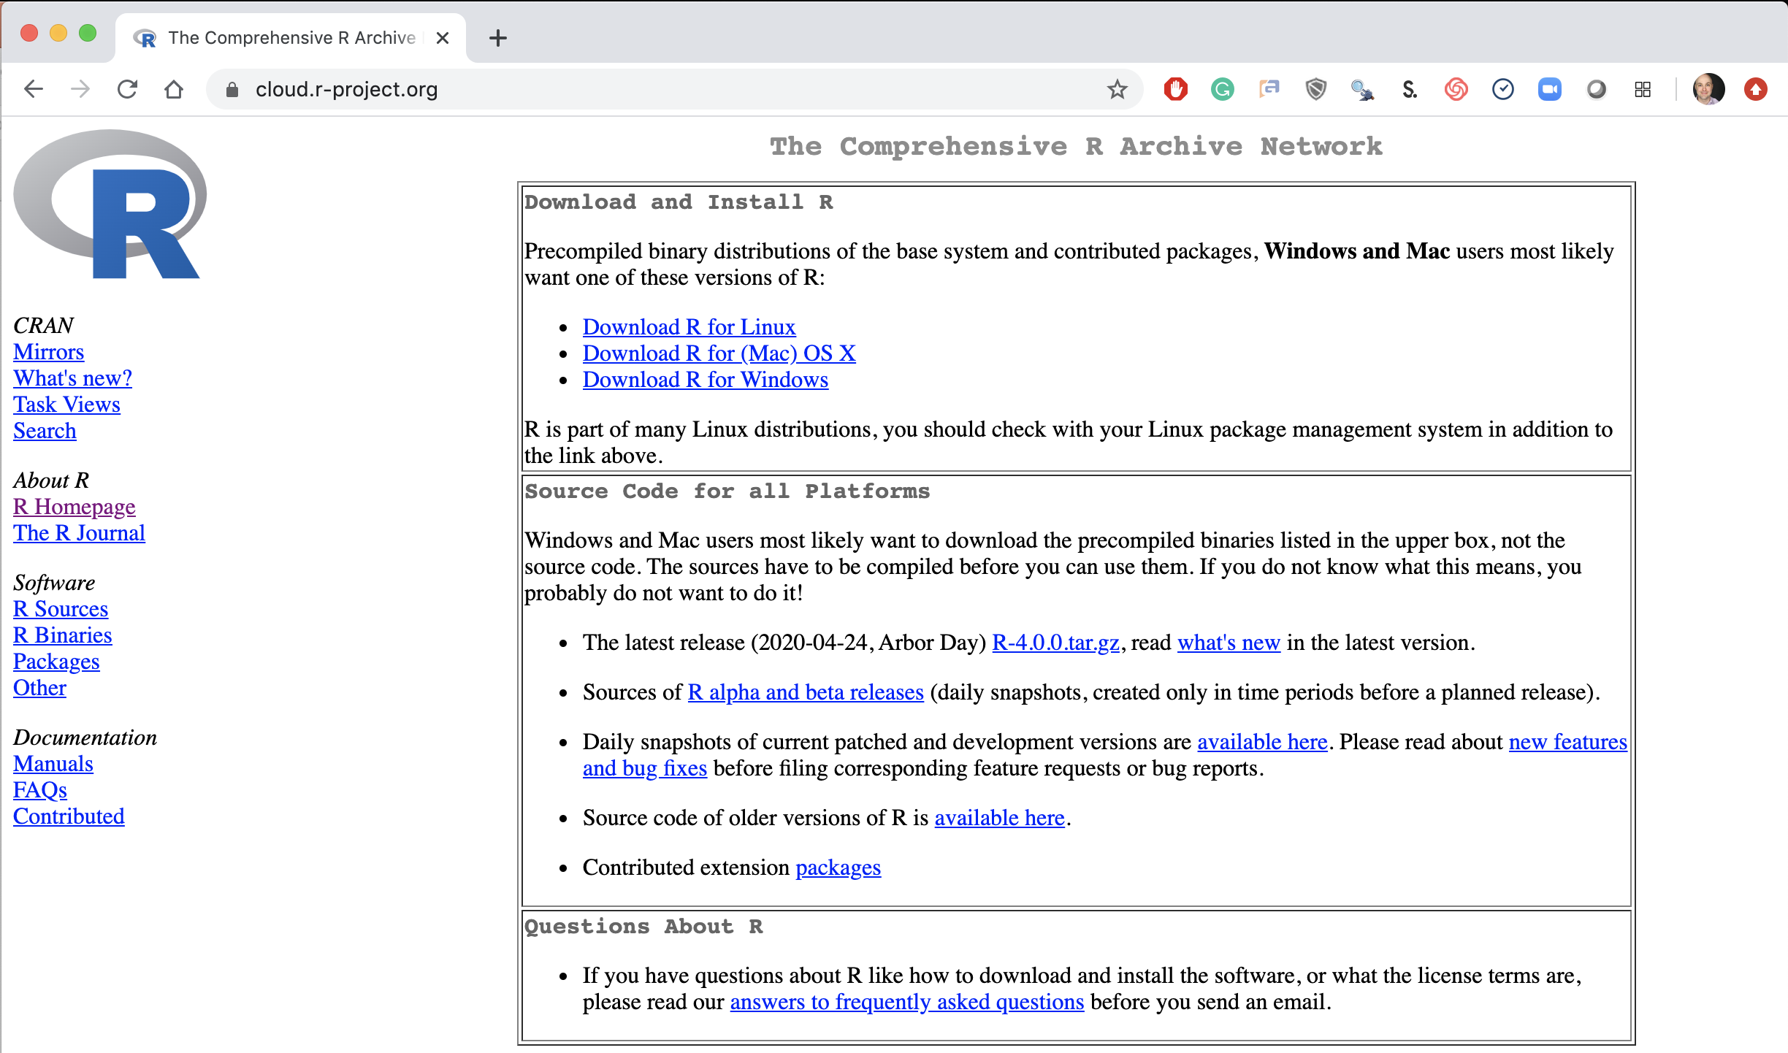
Step 1. Install Base -R
Local Laptop – Windows or Mac
Download the appropriate version Linux, Mac or Windows.
https://cloud.r-project.org/

Slide 5
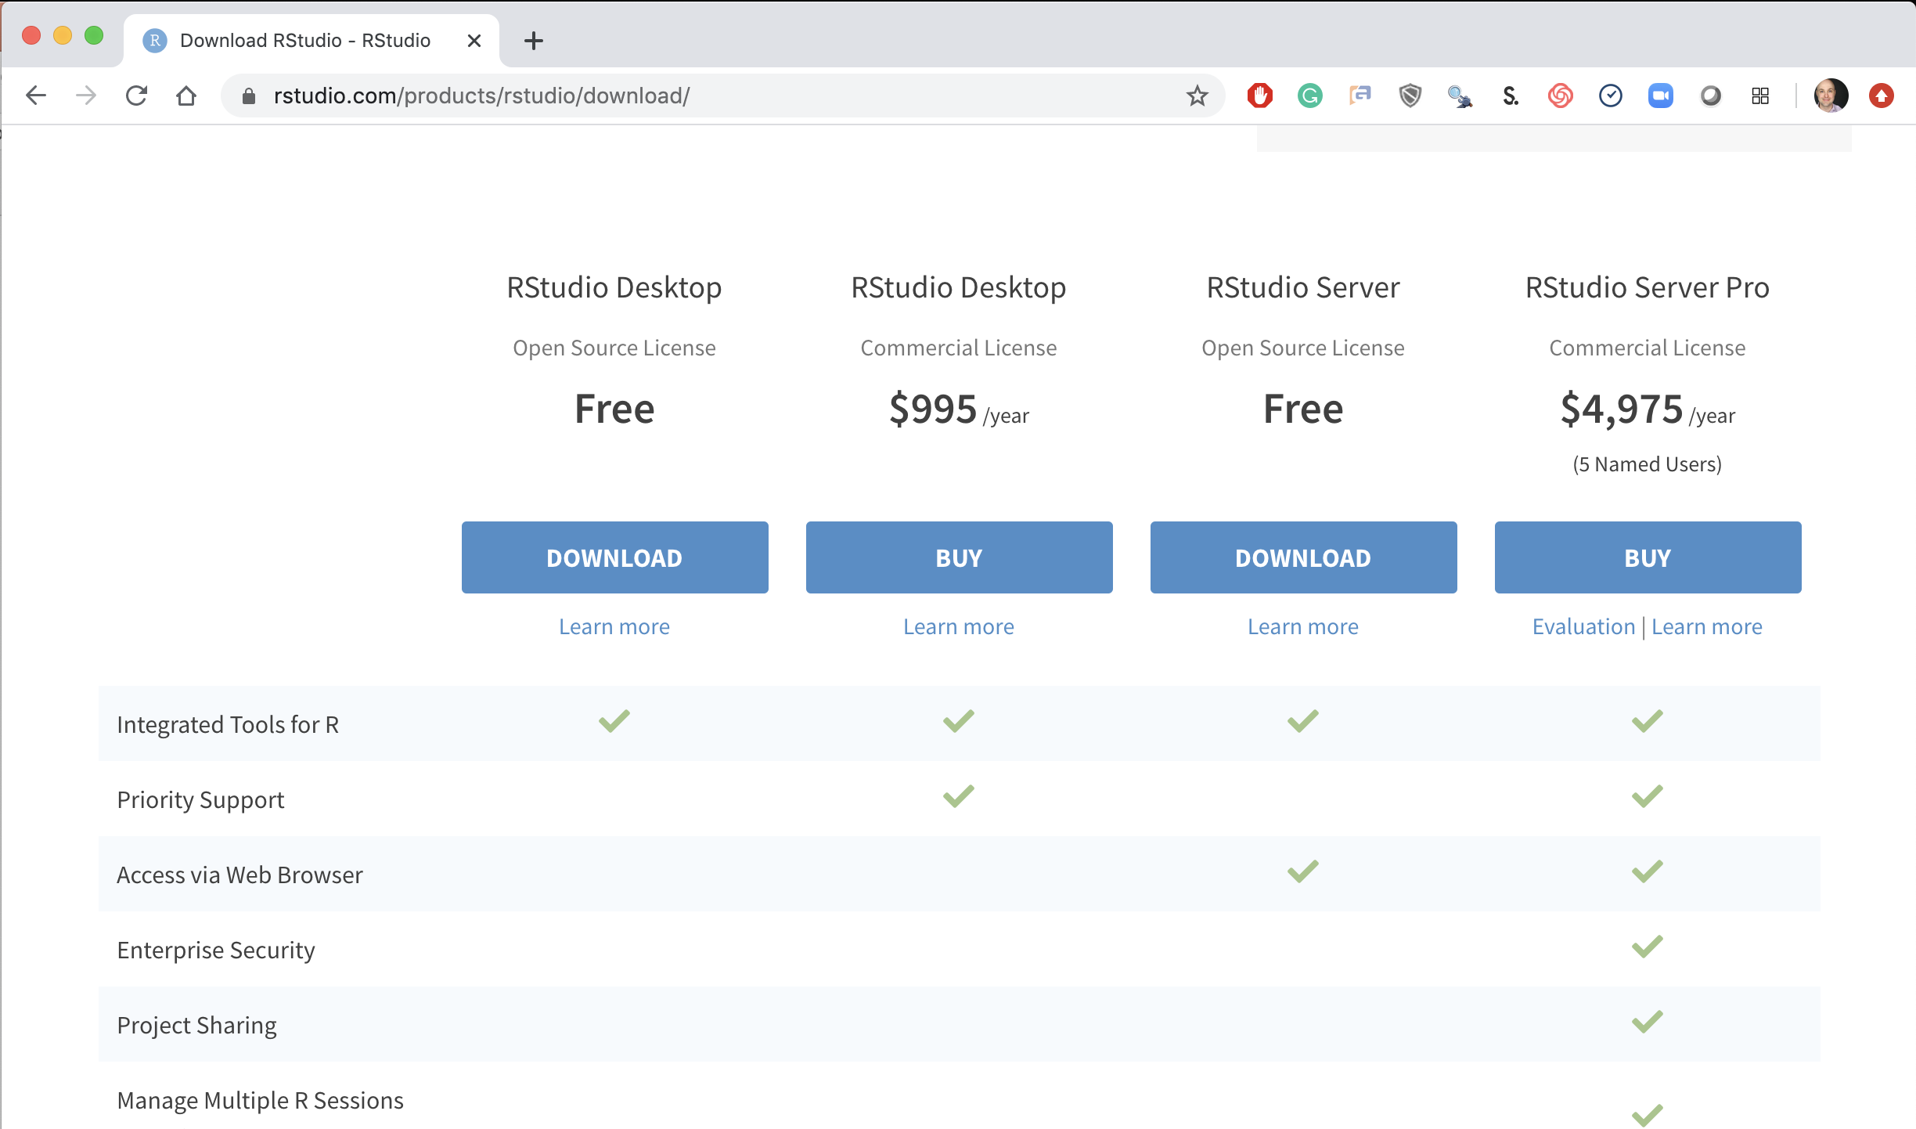
Step 2. Install R-Studio
Local Laptop Windows or Mac
Download the R Studio Desktop (Free).
https://rstudio.com/products/rstudio/download/ &
https://rstudio.com/products/rstudio/download/#download

Slide 6
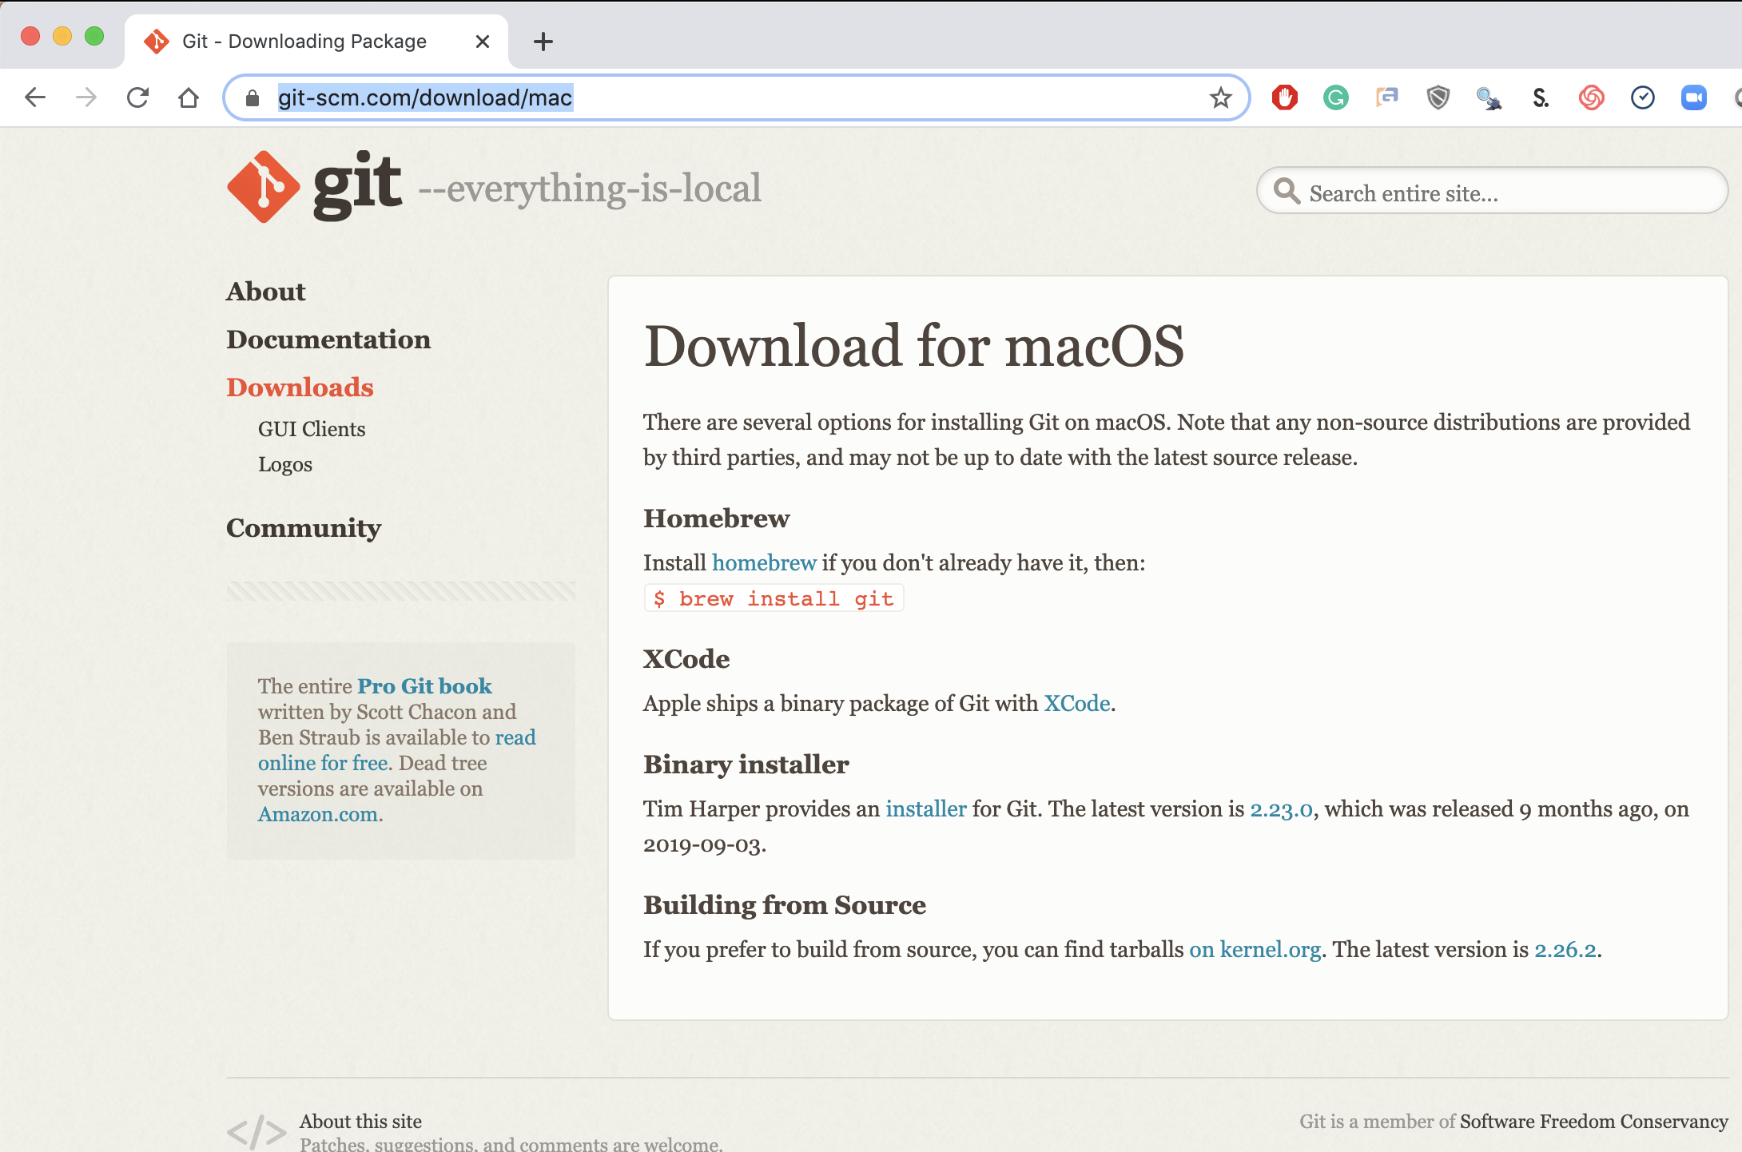
Step 3. Install Git (Mac)
Local Laptop Apple
Download the Git Program, then follow prompts for installation.
https://git-scm.com/download/mac &
https://www.youtube.com/watch?v=twFo9wCpdSU

Slide 7
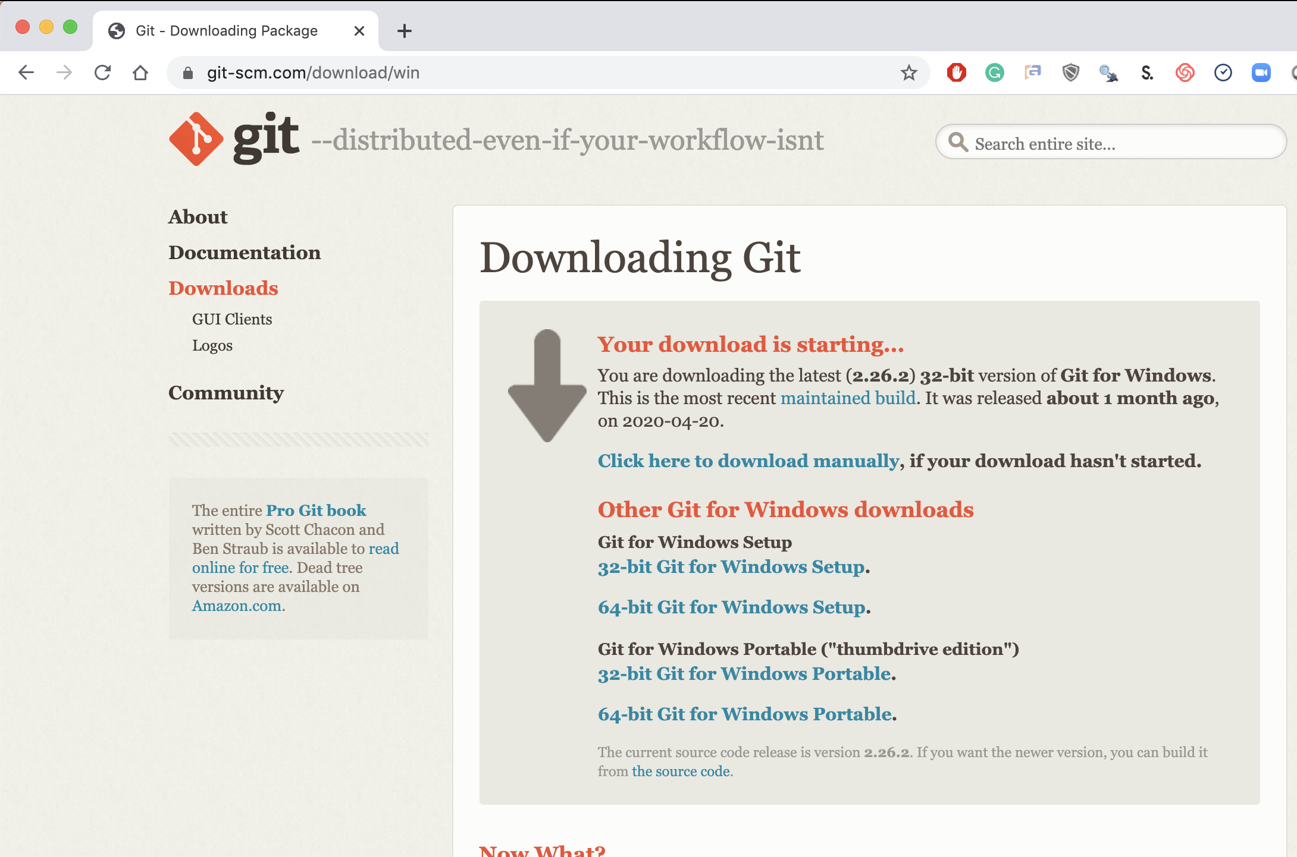
Step 3. Install Git (Windows)
Local Laptop MSFT
Download the Git Program, then follow prompts for installation.
https://git-scm.com/download/win &
https://www.youtube.com/watch?v=nbFwejIsHlY

Slide 8
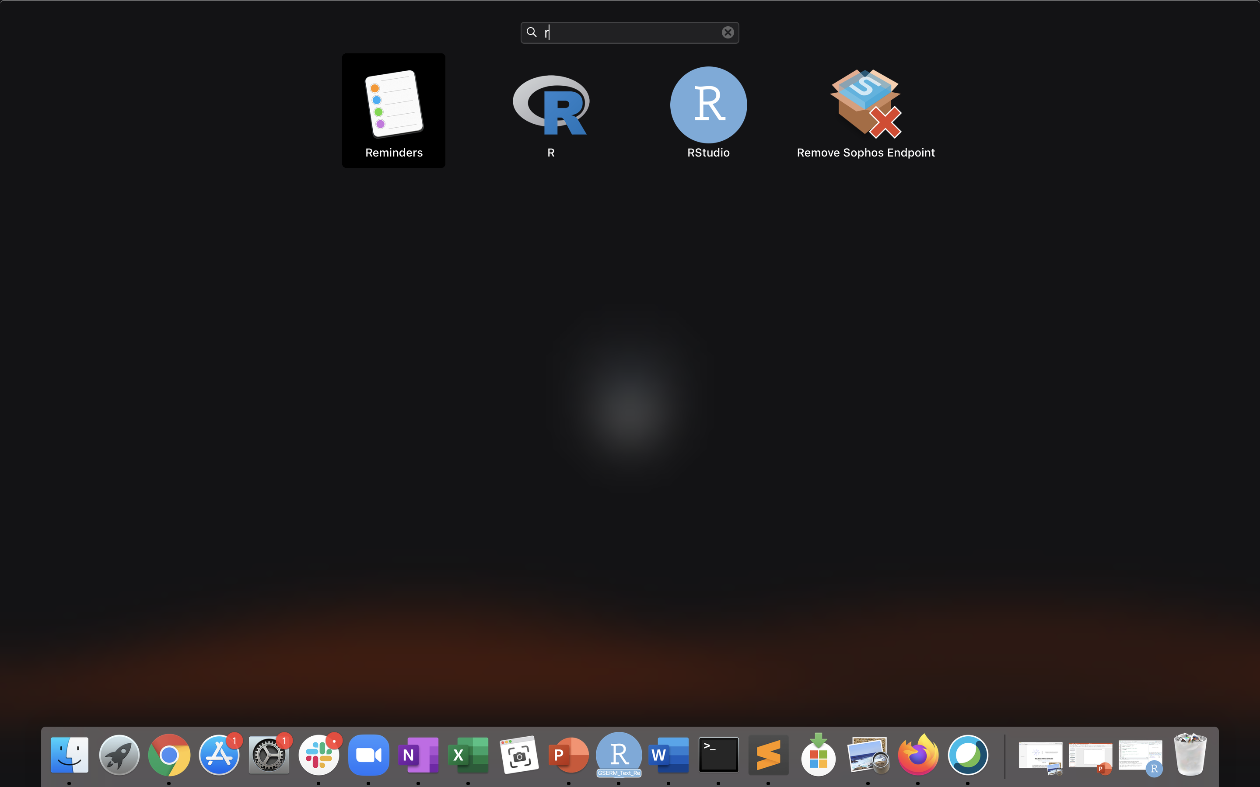
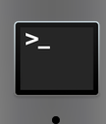
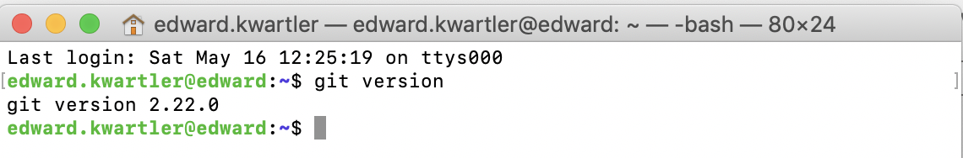
If you are working local you should now have R, R-Studio and git.
Mac: Use “Launchpad” & Type R
Mac: Use: “Terminal” & Type “git version”
Mac: Look for R and R-Studio Icons.

Slide 9
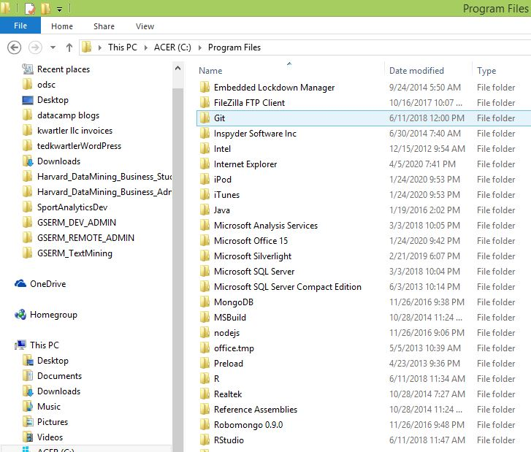
If you are working local you should now have R, R-Studio and git.
Windows: Navigate to the program folder look for git, R and R Studio

Slide 10
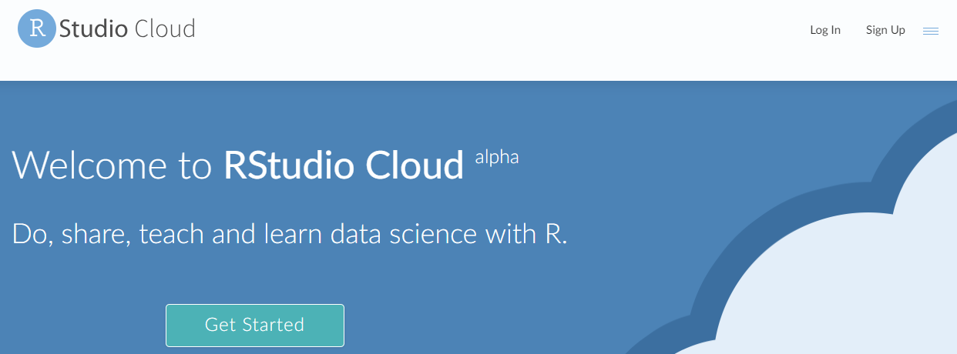
Option 2…free hosted cloud instance
Sign up at:
https://rstudio.cloud/

Slide 11
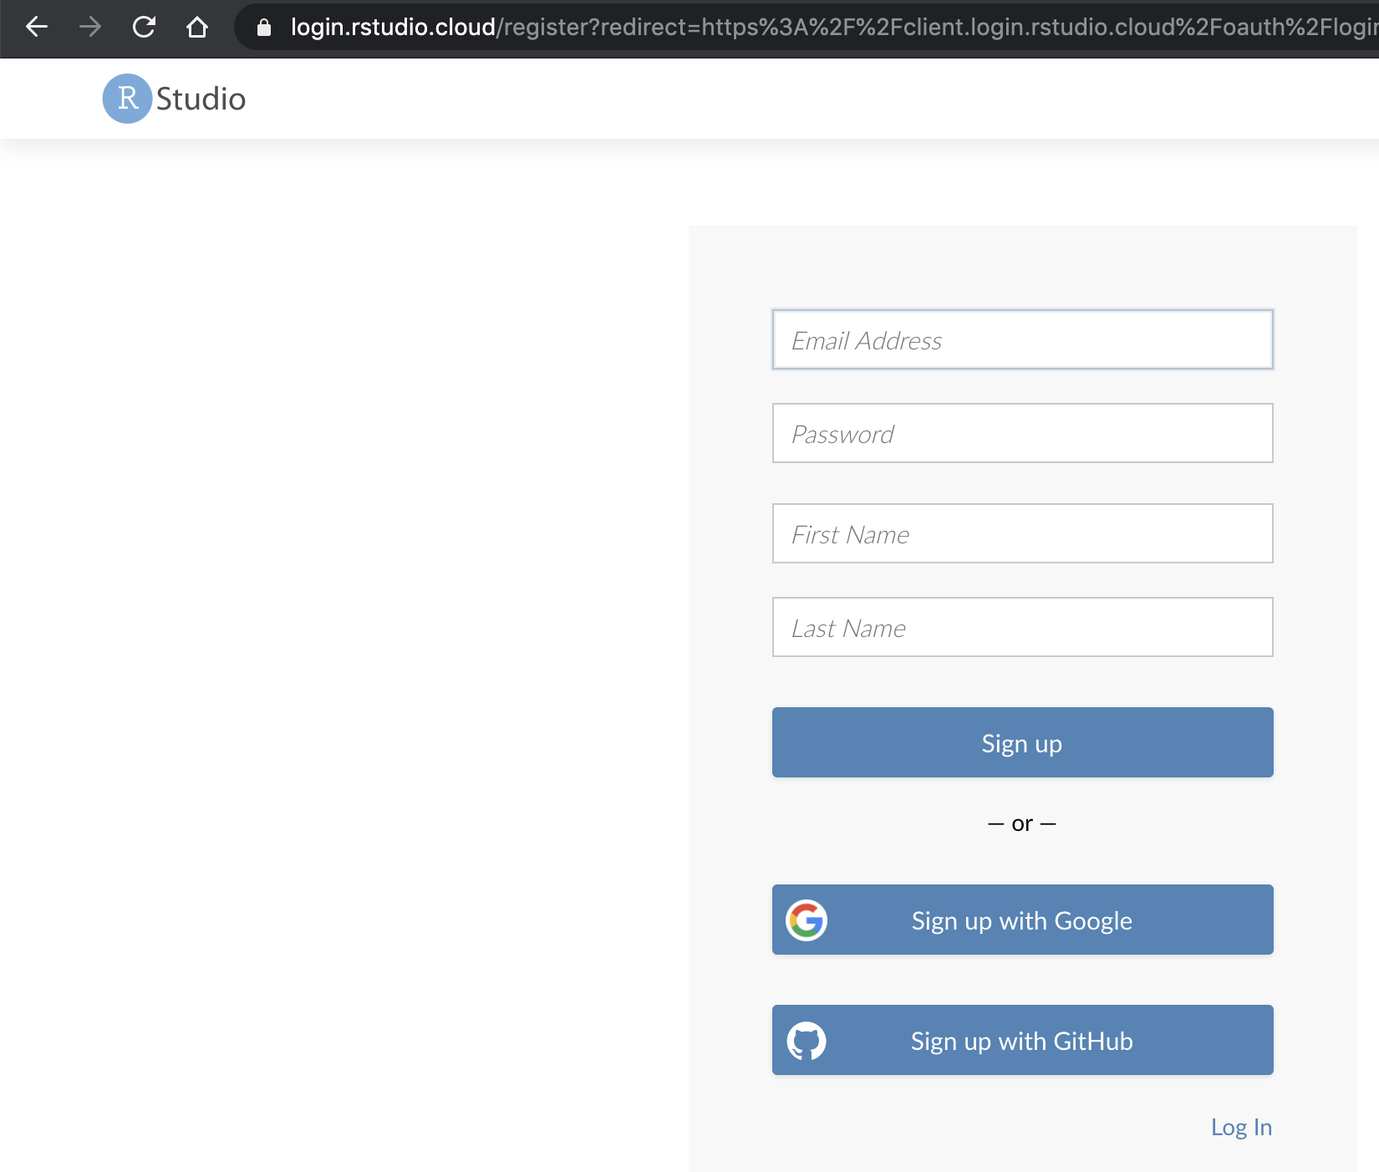
Steps 1, 2 & 3 are done for www.rstudio.cloud!
Cloud
Navigate to www.rstudio.cloud & sign-up!

Slide 12
Now that you have R, R-Studio & Git, time to connect to our class repository.
Connect to git repository.
R Studio sits on top of base R & adds functionality.
Class Files hosted on github.com
Makes the programmatic connection.

Slide 13
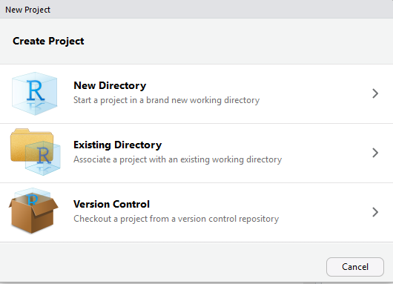
If LOCAL or VM: setup a new project & do a “git pull”
https://github.com/kwartler/<<repo_previously_shared>>
Open R Studio
File
New Project
Version Control

Slide 14
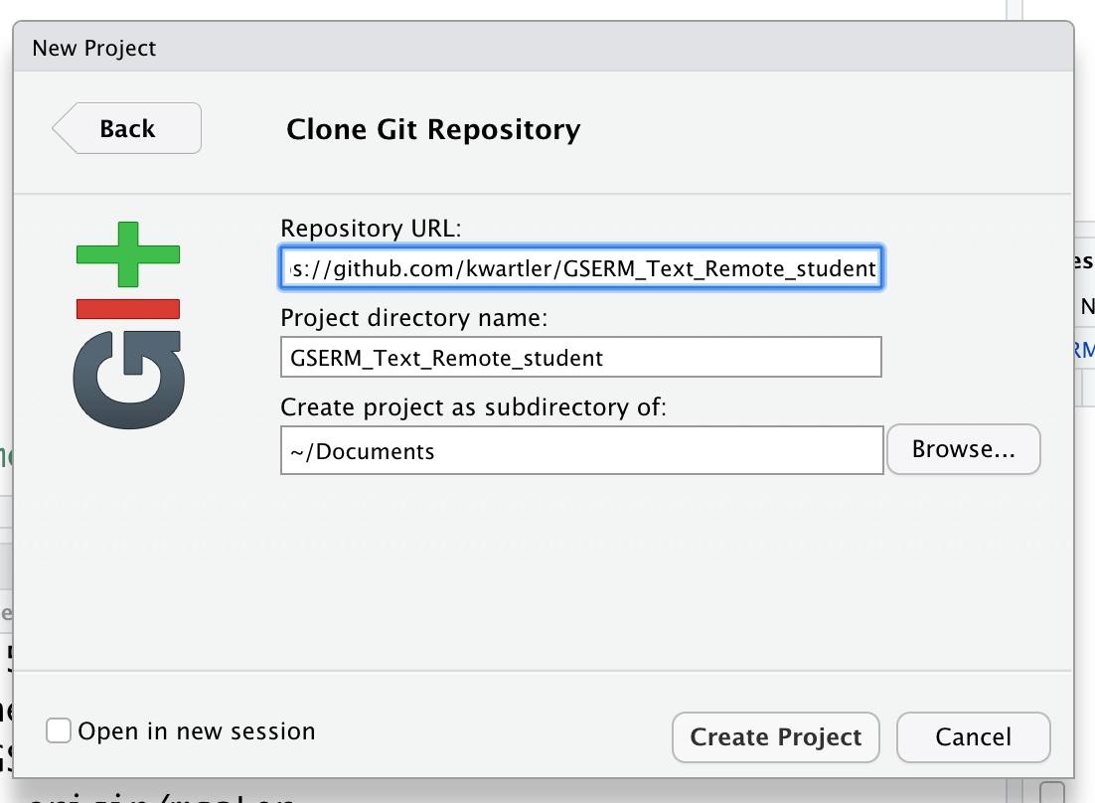
If LOCAL or VM: setup a new project & do a “git pull”
https://github.com/kwartler/<<repo_previously_shared>>
In R Studio
File
New Project…
Version Control
Select Git
Add URL, folder name & destination for files

Slide 15
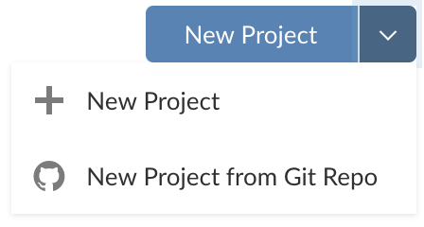
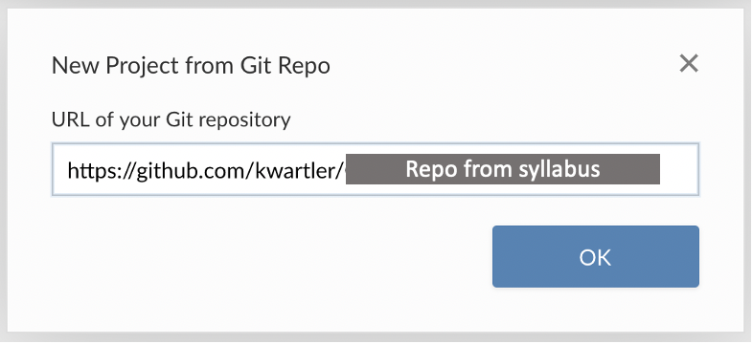
If you are using Rstudio.cloud
In the browser

Slide 16

Then rename your project in the browser
In the browser

Slide 17
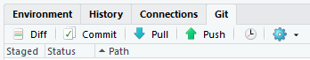
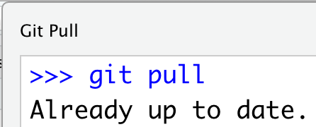
Each day we will perform a git pull.
https://github.com/kwartler/<<repo_in_syllabus>>
In R Studio
File
New Project…
Version Control
Select Git
Add URL, folder name & destination for files
EACH Class session perform a Git Pull to update files

Slide 18
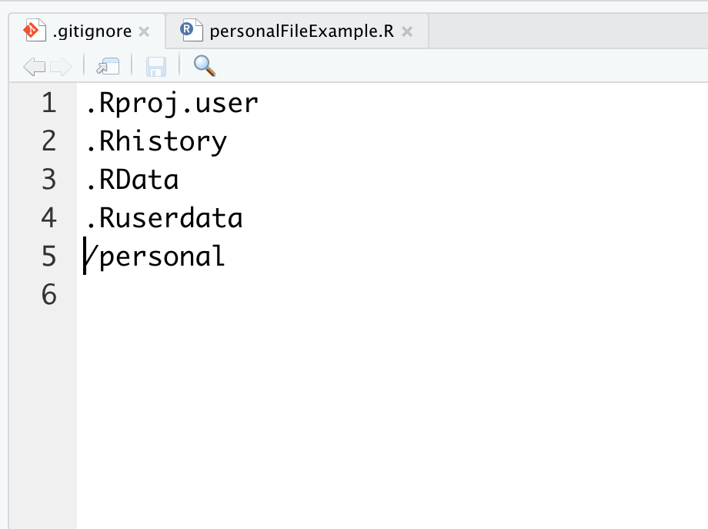
Second to last item. Create a personal folder.
Open the “gitignore” file. Add slash personal
Name of folder to be ignored “personal”
When you work and make changes to scripts, SAVE AS to a personal folder that is ignored by git.

Slide 19
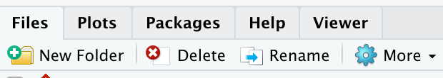
Second to last item. Create a personal folder.
In the lower right file section click “New Folder”. Name it “personal” exactly as in the gitignore (capitalization)
Click New Folder

Slide 20
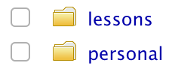
Second to last item. Create a personal folder.
In the lower right file section click “New Folder”. Name it “personal” exactly as in the gitignore (capitalization)
Any file you change should be “Save As” in this folder.

Slide 21
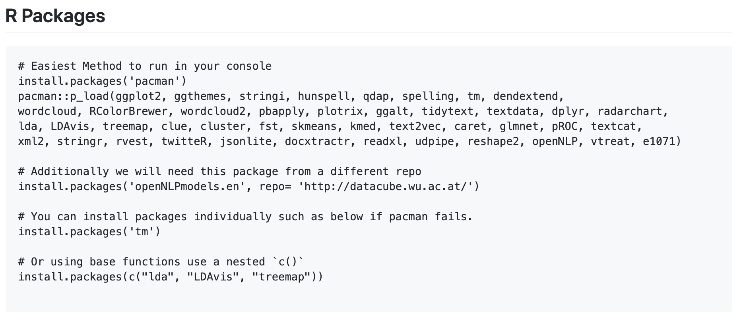
Run some code to set up your environment
https://github.com/kwartler/<<repo_previously_shared>>
If you have R, Rstudio, Git, then made a connection and can run this code…you’re off to a great start! And don’t worry if you hit a hiccup, we will figure it or have you use the free hosted version for today.

Slide 22
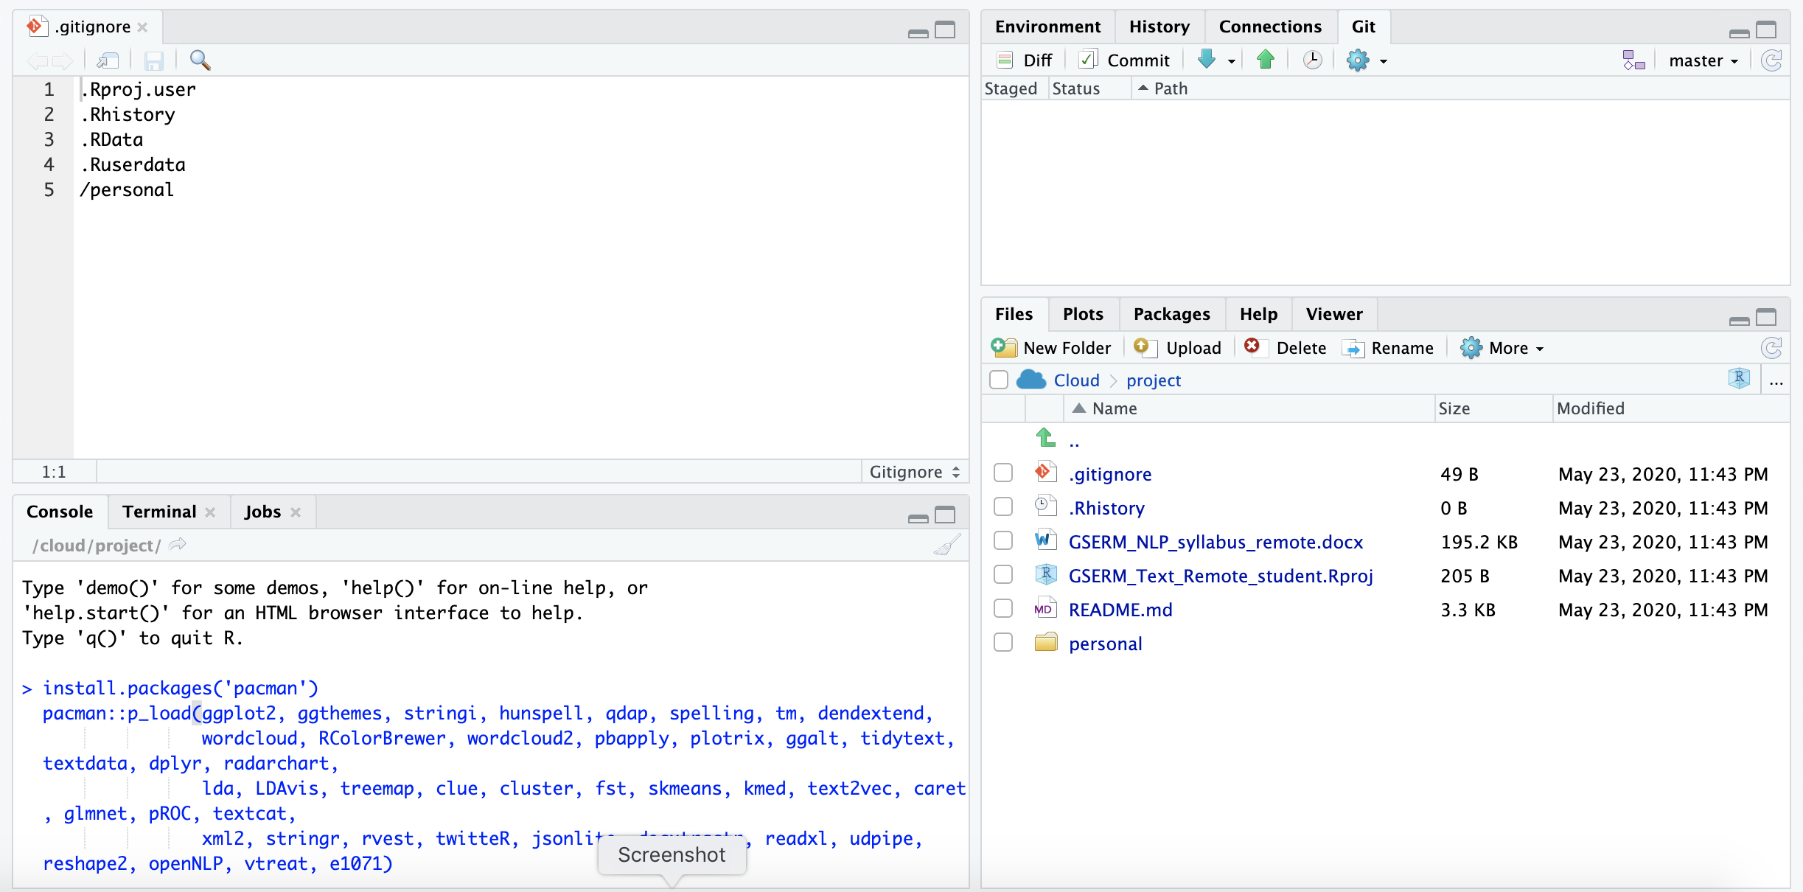
Now just run some code
Copy the first part of the code from the class repository. Then paste it into the “console” (lower left of your R session) & hit enter..
Do this step at a time when you don’t need your laptop, VM or can just leave your browser open depending on your method of accessing the software.

Slide 23
Almost setup…don’t worry if you need help.

